Slide 1
SQL ANS

Slide 2
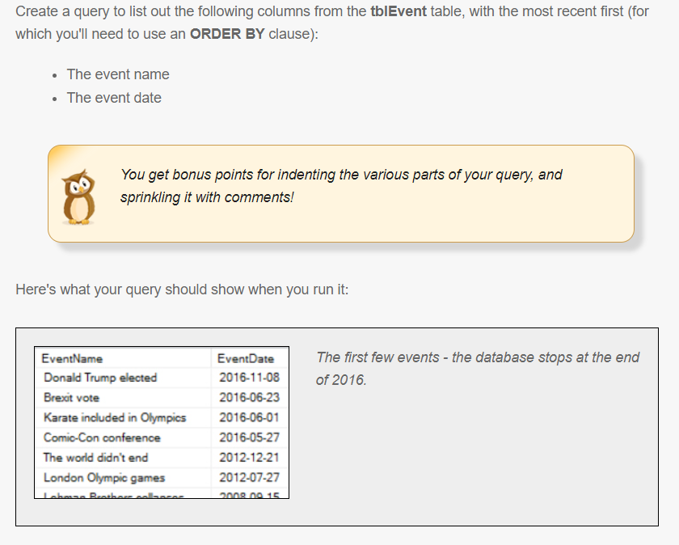
Simple Queries
Question 1

Slide 3
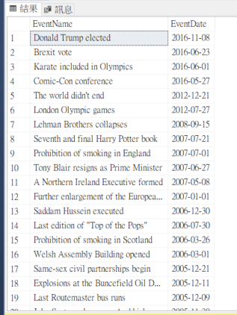
Answer 1
SELECT
e.EventName,
e.EventDate
FROM tblEvent AS e
ORDER BY e.EventDate desc

Slide 4
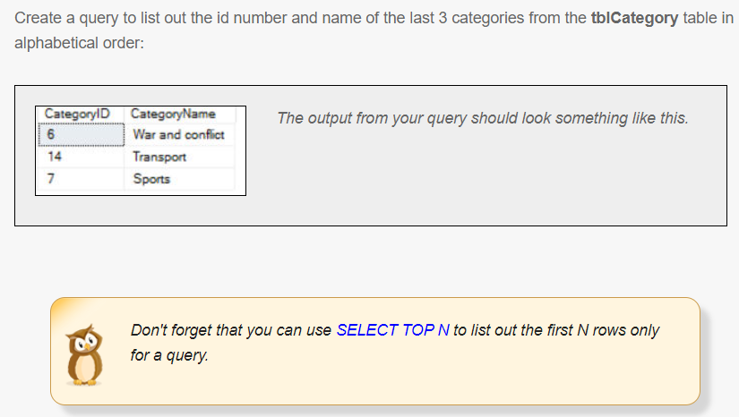
Simple Queries
Question 2

Slide 5
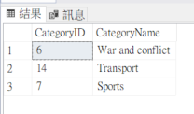
Answer 2
SELECT TOP 3
a.CategoryID,
a.CategoryName
FROM tblCategory AS a
ORDER BY a.CategoryName desc

Slide 6
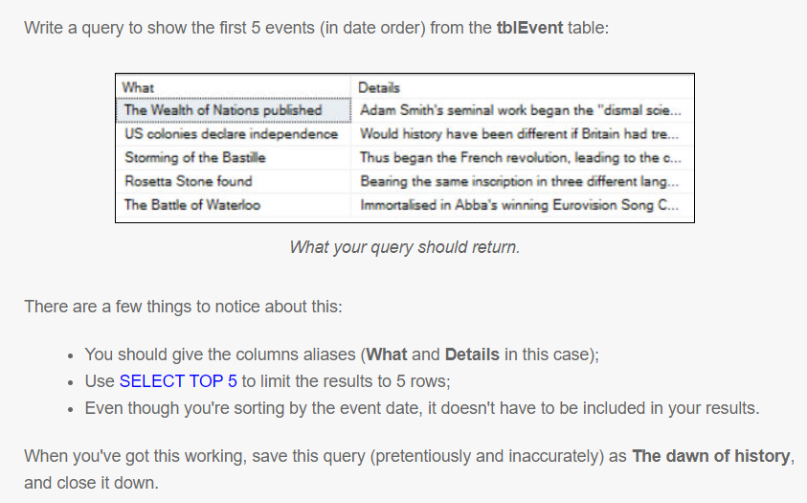
Simple Queries
Question 3

Slide 7
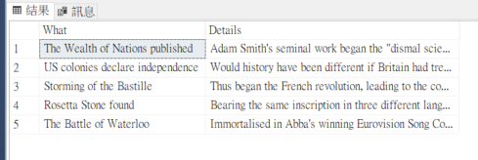
Answer 3
SELECT TOP 5
a.EventName AS 'What',
a.EventDetails AS 'Details'
FROM tblEvent AS a
ORDER BY a.EventDate asc

Slide 8
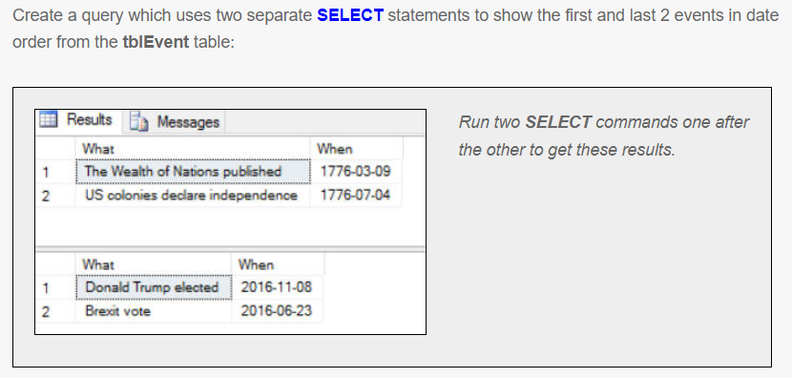
Simple Queries
Question 4

Slide 9
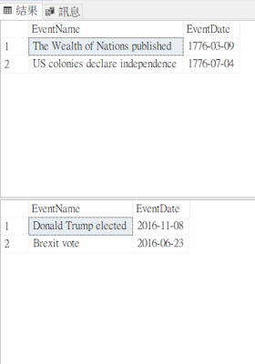
Answer 4
SELECT TOP 2
a.EventName,
a.EventDate
FROM tblEvent AS a
ORDER BY a.EventDate asc
SELECT TOP 2
a.EventName,
a.EventDate
FROM tblEvent AS a
ORDER BY a.EventDate desc

Slide 10
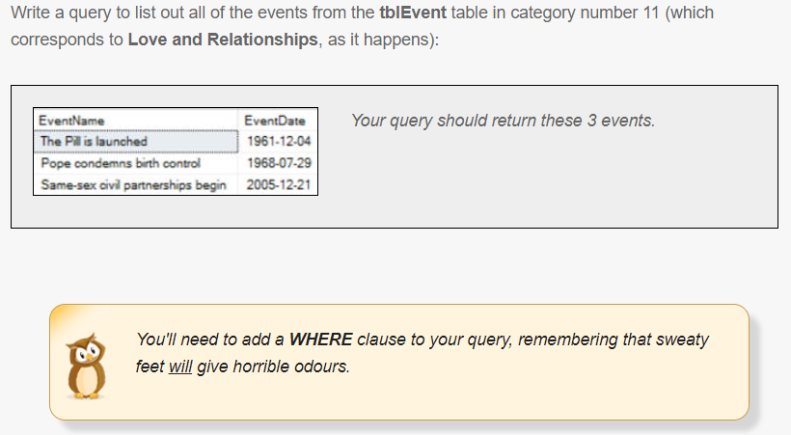
SETTING CRITERIA USING WHERE
Question 1

Slide 11
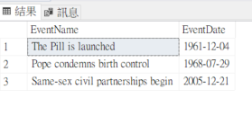
Answer 1
SELECT
a.EventName,
a.EventDate
FROM tblEvent AS a
WHERE a.CategoryID=11
ORDER BY a.CategoryID

Slide 12
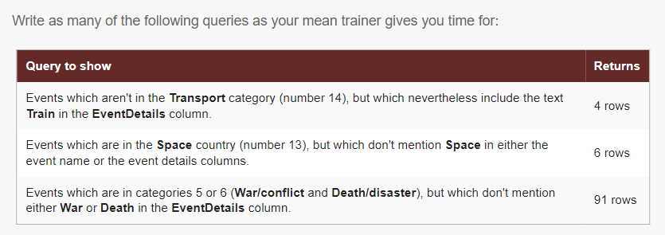
SETTING CRITERIA USING WHERE
Question 2

Slide 13
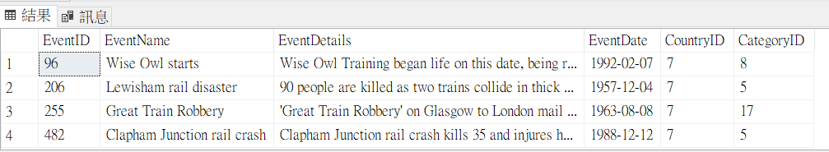
Answer 2
SELECT*
FROM
tblEvent AS e
WHERE
e.CategoryID <> 14 and
(e.EventDetails like '%train%')

Slide 14
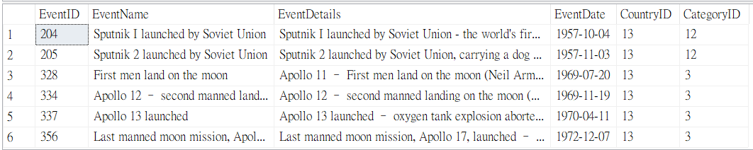
Answer 2
SELECT *
FROM
tblEvent AS a
WHERE
a.CountryID =13 and
a.EventDetails not like '%space%' and
a.EventName not like '%space%'

Slide 15
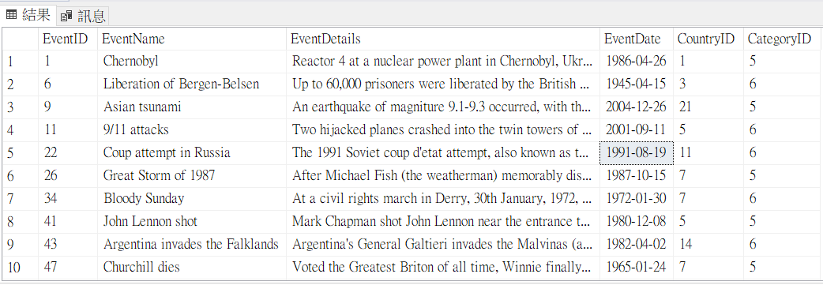
Answer 2
SELECT *
FROM
tblEvent AS a
WHERE
a.CategoryID in (5,6) and
a.EventDetails not like '%War%' and
a.EventDetails not like '%Death%'

Slide 16
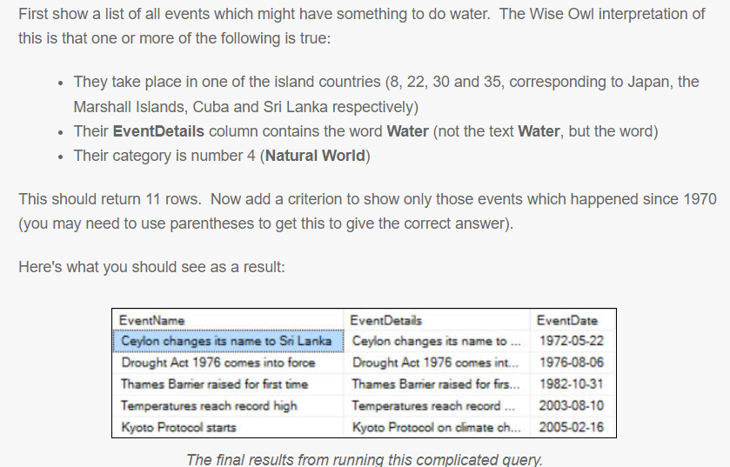
SETTING CRITERIA USING WHERE
Question 3

Slide 17
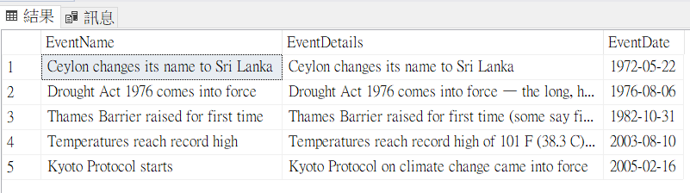
Answer 3
SELECT
a.EventName,
a.EventDetails,
a.EventDate
FROM tblEvent AS a
WHERE
(
a.CountryID IN (8,22,30,35)
or a.EventDetails like '% Water %'
or a.EventDetails like '% Water'
or a.EventDetails like 'Water %'
or a.CategoryID = 4
)
and a.EventDate >= '19700101'

Slide 18
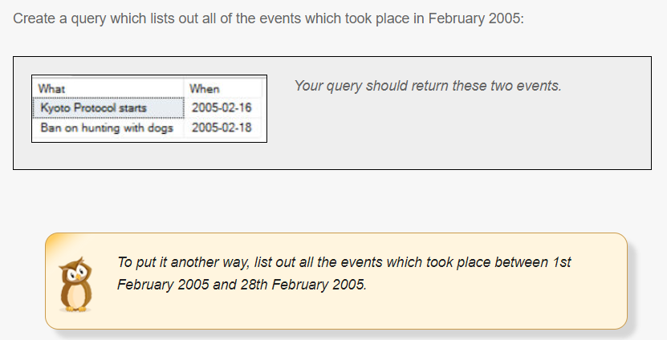
SETTING CRITERIA USING WHERE
Question 4

Slide 19
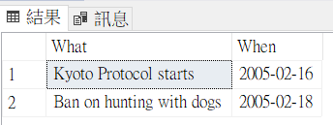
Answer 4
SELECT
a.EventName AS 'What',
a.EventDate AS 'When'
FROM tblEvent AS a
WHERE
a.EventDate between '20050201' and '20050228'

Slide 20
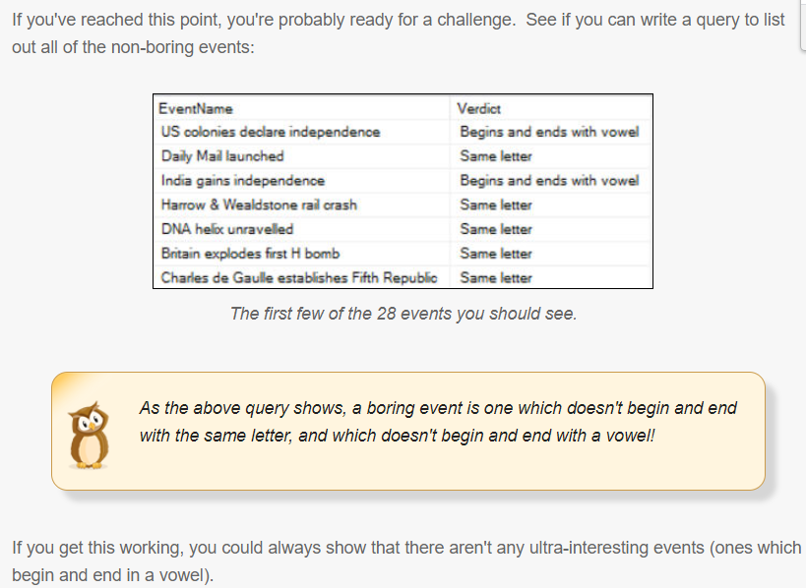
CALCULATIONS
Question 1

Slide 21
Answer 1
SELECT
e.EventName,
CASE
-- this would show events beginning and ending with the same letter, where this is also a vowel
WHEN CHARINDEX(left(e.EventName,1),'aeiou',1)>0 and left(e.EventName,1)=right(e.EventName,1)
THEN 'Same vowel'
-- ones where the left and right letter are the same
WHEN left(e.EventName,1)=right(e.EventName,1)
THEN 'Same letter'

Slide 22
-- ones where both left and right letters are in the string of vowels
WHEN CHARINDEX(left(e.EventName,1),'aeiou',1)>0 and CHARINDEX(right(e.EventName,1),'aeiou',1)>0
THEN 'Begins and ends with vowel'
-- the rest!
ELSE 'Boring event!'
END AS Verdict
FROM tblEvent AS e
WHERE
-- omit the boring ones
CASE
WHEN left(e.EventName,1)=right(e.EventName,1)
THEN 'Same letter'
WHEN CHARINDEX(left(e.EventName,1),'aeiou',1)>0 and CHARINDEX(right(e.EventName,1),'aeiou',1)>0
THEN 'Begins and ends with vowel'
ELSE 'Boring event!'
END <> 'Boring event!'
ORDER BY e.EventDate asc

Slide 23
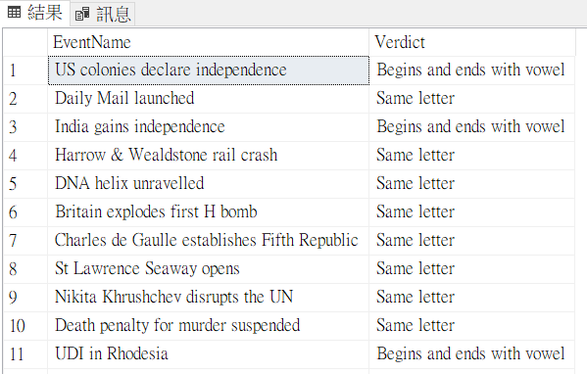

Slide 24
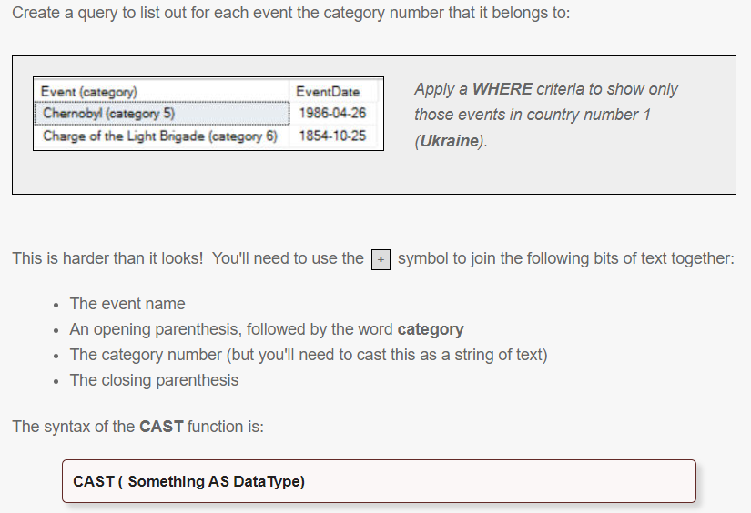
CALCULATIONS
Question 2

Slide 25
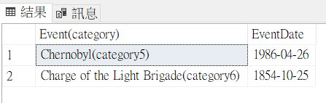
Answer 2
SELECT
a.EventName+
'(category' +
CAST(a.CategoryID AS VARCHAR(100)) +
')' AS 'Event(category)',
a.EventDate
FROM tblEvent AS a
WHERE
a.CountryID=1

Slide 26
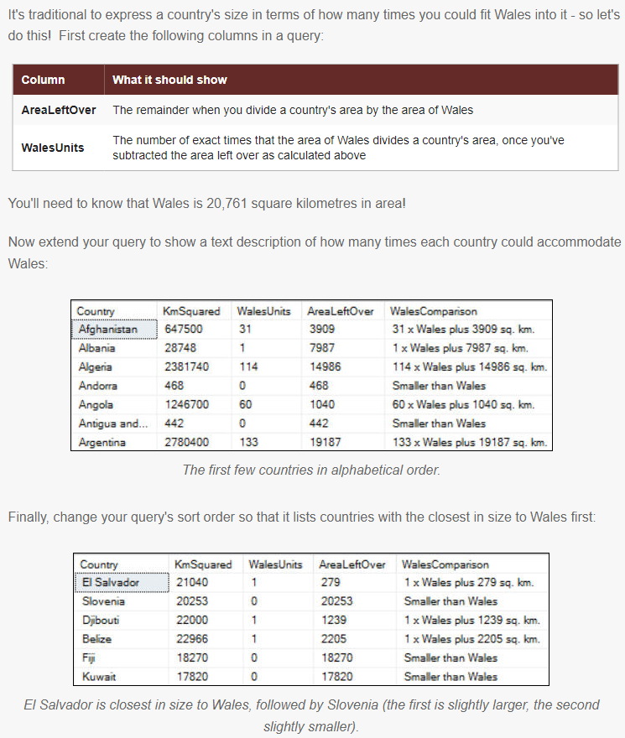
CALCULATIONS
Question 3

Slide 27
Answer 3
SELECT
c.Country,
c.KmSquared,
(c.KmSquared-c.KmSquared % 20761)/20761 AS WalesUnits,
c.KmSquared % 20761 AS AreaLeftOver,
CASE
WHEN c.KmSquared < 20761 THEN 'Smaller than Wales'
ELSE CAST((c.KmSquared-c.KmSquared % 20761)/20761 as varchar(100)) +'x Wales plus '
+ CAST((c.KmSquared % 20761)as varchar(100))
+'sq. km.'
END AS WalesComparison
FROM CountriesByArea AS c
ORDER BY ABS(20761-c.KmSquared) ASC

Slide 28
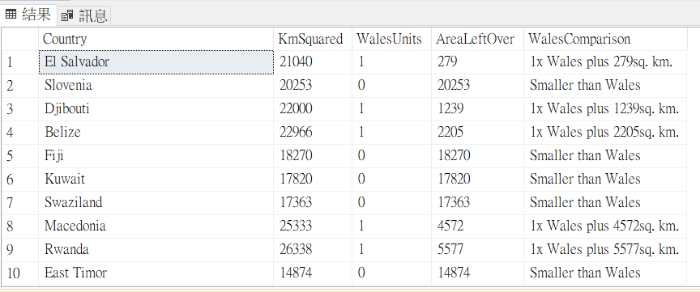

Slide 29
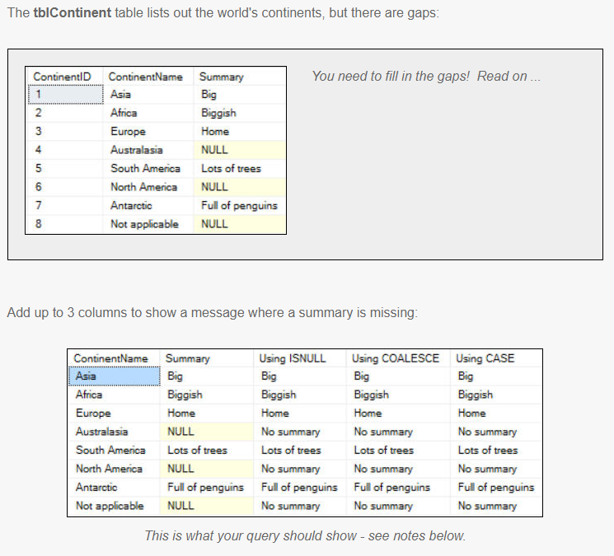
CALCULATIONS
Question 4

Slide 30
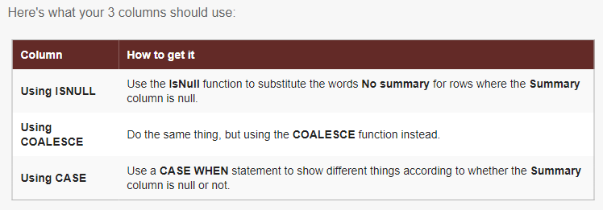

Slide 31
Answer 4
SELECT
t.ContinentName,
t.Summary,
--Using ISNULL
ISNULL(t.Summary,'No summary') AS 'Using ISNULL',
--Using COALESCE
COALESCE(t.Summary,'No summary') AS 'Using COALESCE',
--Using CASE
CASE
WHEN t.Summary is null THEN 'No summary'
ELSE t.Summary
END AS 'Using CASE'
FROM tblContinent as t

Slide 32
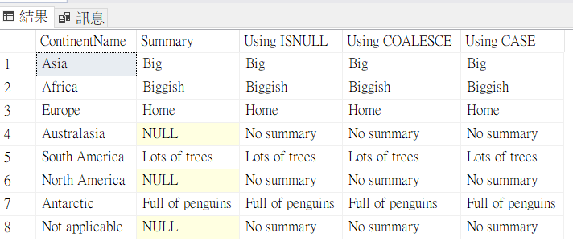

Slide 33
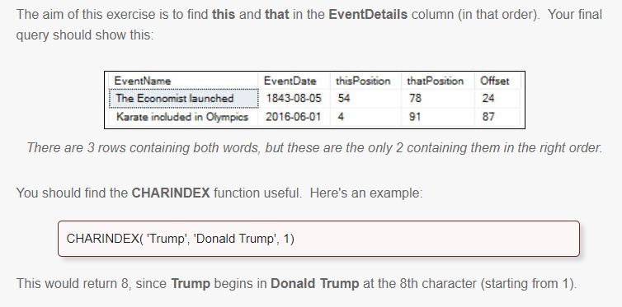
CALCULATIONS
Question 5

Slide 34
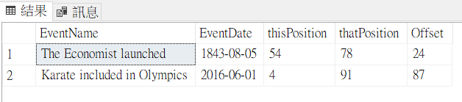
Answer 5
SELECT
t.EventName,
t.EventDate,
CHARINDEX('this',t.EventDetails) AS thisPosition,
CHARINDEX('that',t.EventDetails) AS thatPosition,
CHARINDEX('that',t.EventDetails)-CHARINDEX('this',t.EventDetails) AS Offset
FROM tblEvent AS t
WHERE
CHARINDEX('this',t.EventDetails) > 0 and
CHARINDEX('that',t.EventDetails) > 0 and
CHARINDEX('that',t.EventDetails)-CHARINDEX('this',t.EventDetails) > 0

Slide 35
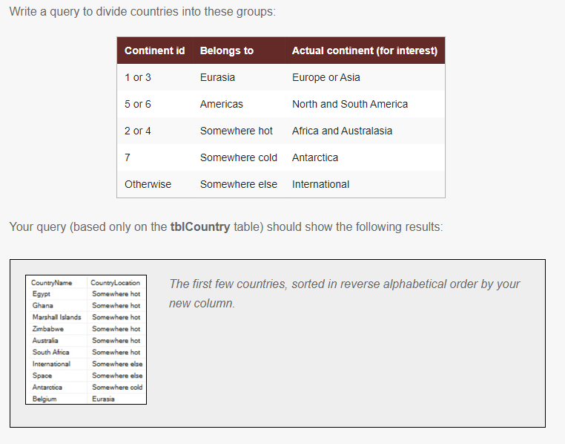
CALCULATIONS
Question 6

Slide 36
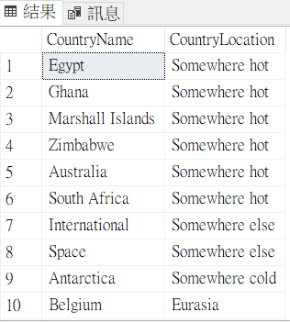
Answer 6
SELECT
t.CountryName,
CASE
WHEN t.ContinentID in (1,3) THEN 'Eurasia'
WHEN t.ContinentID in (5,6) THEN 'Americas'
WHEN t.ContinentID in (2,4) THEN 'Somewhere hot'
WHEN t.ContinentID = 7 THEN 'Somewhere cold'
ELSE 'Somewhere else'
END AS CountryLocation
FROM tblCountry t
ORDER BY CountryLocation desc

Slide 37
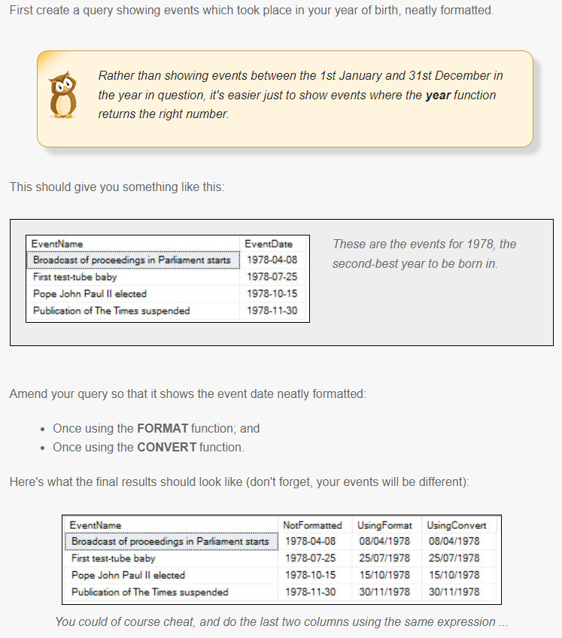
CALCULATIONS USING DATES
Question 1

Slide 38
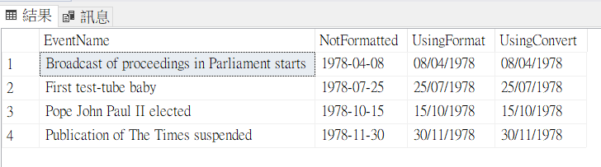
Answer 1
SELECT
e.EventName,
e.EventDate AS NotFormatted,
FORMAT(e.EventDate, 'dd/MM/yyyy' ) AS UsingFormat,
CONVERT(NVARCHAR(10),e.EventDate,103 ) AS UsingConvert
FROM
tblEvent AS e
WHERE
year(e.EventDate) = 1978
ORDER BY e.EventDate asc

Slide 39
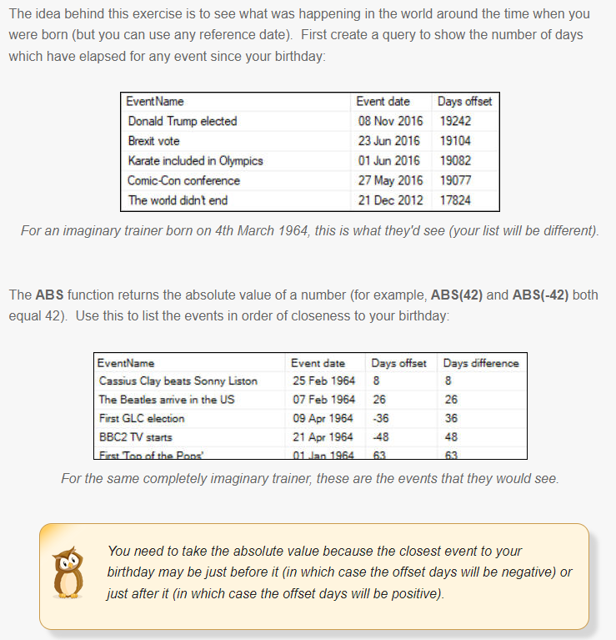
CALCULATIONS USING DATES
Question 2

Slide 40
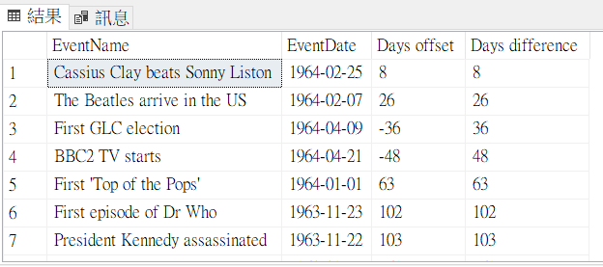
Answer 2
SELECT
t.EventName,
t.EventDate,
DATEDIFF(day,t.EventDate,'19640304') AS 'Days offset',
ABS(DATEDIFF(day,t.EventDate,'19640304')) AS 'Days difference'
FROM tblEvent AS t
ORDER BY 'Days difference' asc

Slide 41
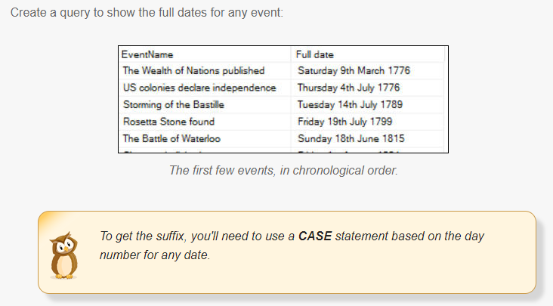
CALCULATIONS USING DATES
Question 3

Slide 42
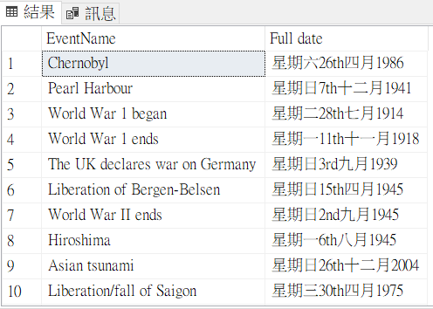
Answer 3
SELECT
t.EventName,
DATENAME(weekday,t.EventDate)+
DATENAME(day,t.EventDate)+
CASE
WHEN DATEPART(day,t.EventDate) IN (1,21,31) THEN 'st'
WHEN DATEPART(day,t.EventDate) IN (2,22) THEN 'nd'
WHEN DATEPART(day,t.EventDate) IN (3,23) THEN 'rd'
ELSE 'th'
END +
DATENAME(month,t.EventDate)+
DATENAME(year,t.EventDate)
AS 'Full date'
FROM tblEvent AS t

Slide 43
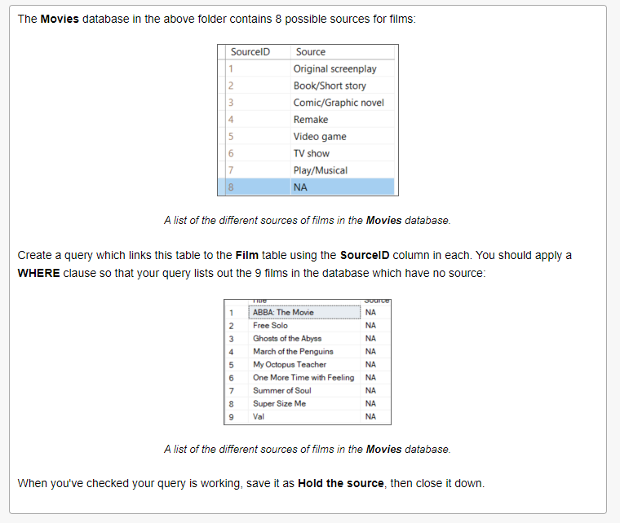
BASIC JOINS
Question 1

Slide 44
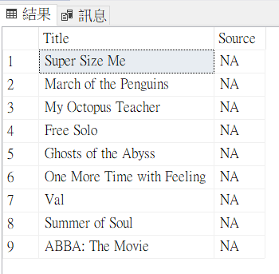
Answer 1
SELECT
f.Title,
s.Source
FROM
Film as f
JOIN Source AS s ON s.SourceID=f.SourceID
WHERE
s.Source='NA'

Slide 45
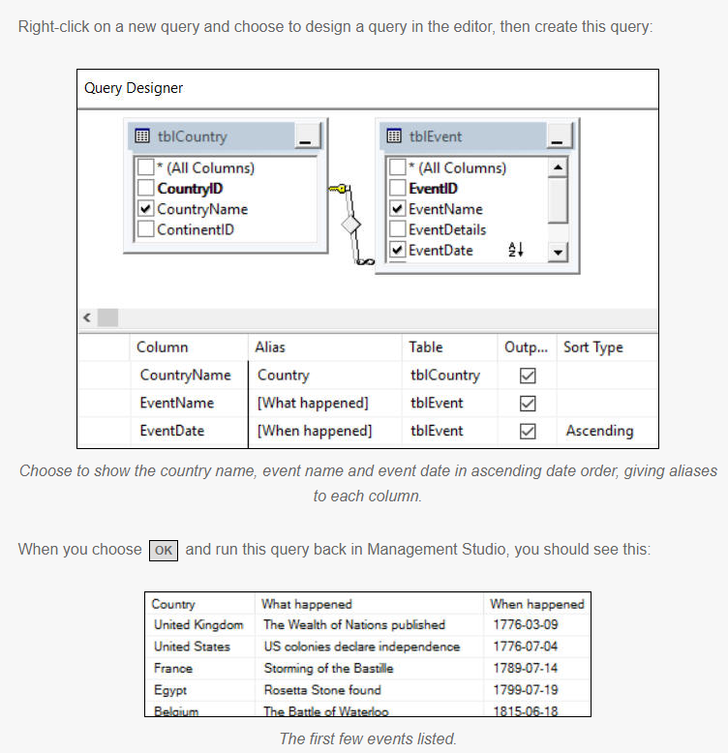
BASIC JOINS
Question 2

Slide 46
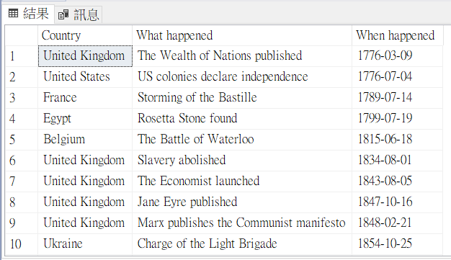
Answer 2
SELECT
tblCountry.CountryName AS Country,
tblEvent.EventName AS [What happened],
tblEvent.EventDate AS [When happened]
FROM
tblCountry
INNER JOIN tblEvent
ON tblCountry.CountryID = tblEvent.CountryID
ORDER BY
[When happened]

Slide 47
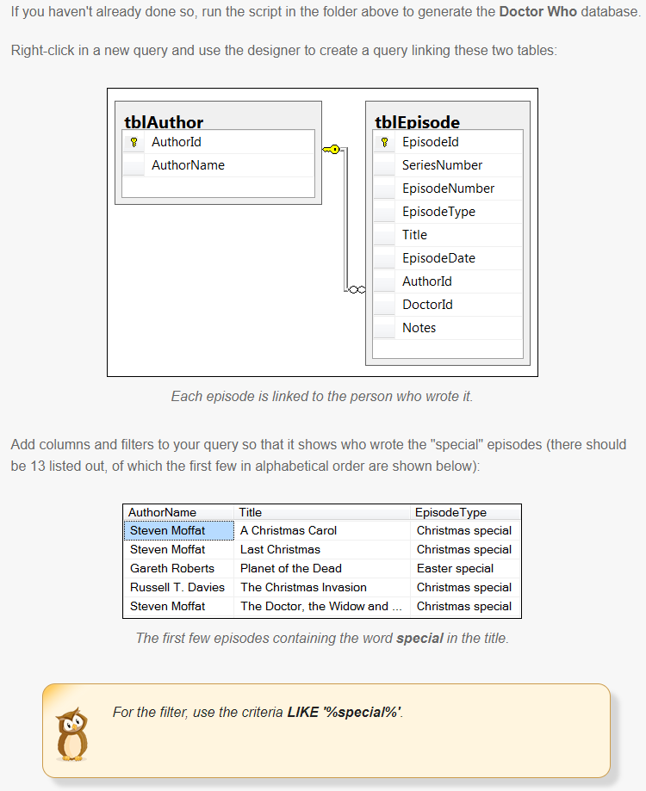
BASIC JOINS
Question 3

Slide 48
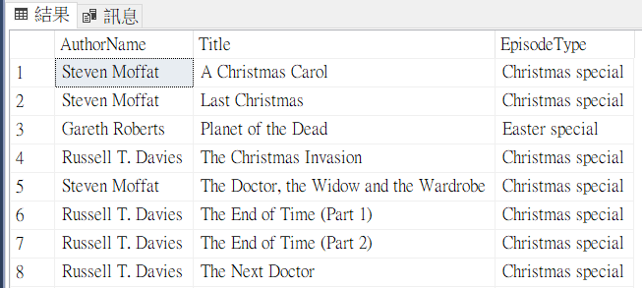
Answer 3
SELECT
tblAuthor.AuthorName,
tblEpisode.Title,
tblEpisode.EpisodeType
FROM
tblAuthor
INNER JOIN tblEpisode ON
tblAuthor.AuthorId = tblEpisode.AuthorId
WHERE
tblEpisode.EpisodeType LIKE '%special%'
ORDER BY
tblEpisode.Title

Slide 49
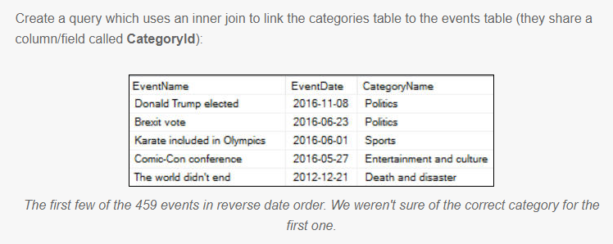
BASIC JOINS
Question 4

Slide 50
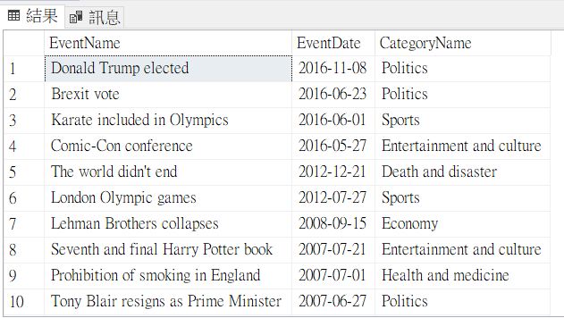
SELECT
tblEvent.EventName,
tblEvent.EventDate,
tblCategory.CategoryName
FROM
tblEvent
INNER JOIN tblCategory ON
tblEvent.CategoryID = tblCategory.CategoryID
ORDER BY
tblEvent.EventDate desc

Slide 51
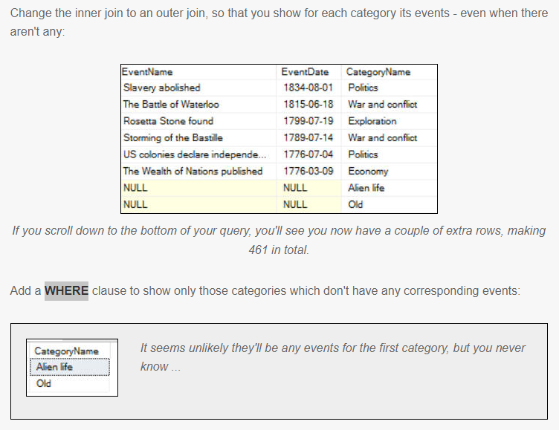

Slide 52
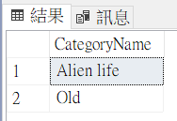
Answer 4
SELECT
tblCategory.CategoryName
FROM
tblEvent
RIGHT OUTER JOIN tblCategory ON
tblEvent.CategoryID = tblCategory.CategoryID
WHERE
tblEvent.EventID is null
ORDER BY
tblEvent.EventDate desc

Slide 53
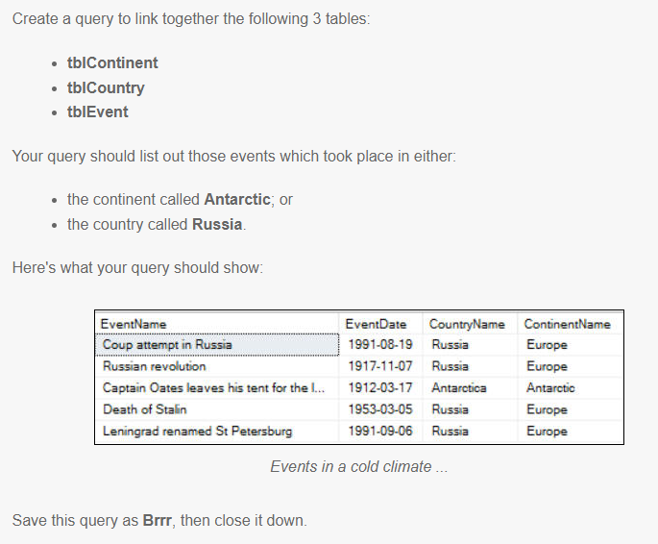
BASIC JOINS
Question 5

Slide 54
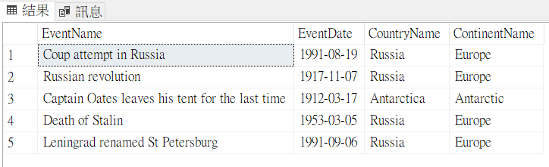
Answer 5
SELECT
e.EventName,
e.EventDate,
t.CountryName,
c.ContinentName
FROM
tblCountry AS t
INNER JOIN tblContinent AS c ON
t.ContinentID = c.ContinentID
INNER JOIN tblEvent AS e ON
t.CountryID = e.CountryID
WHERE
c.ContinentName='Antarctic' or
t.CountryName='Russia'

Slide 55
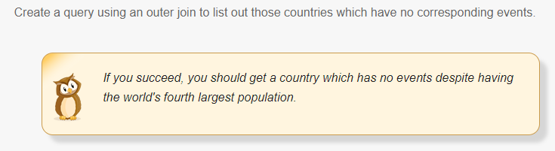
BASIC JOINS
Question 6

Slide 56

Answer 6
SELECT
c.CountryName
FROM
tblCountry AS c
LEFT OUTER JOIN tblEvent AS e ON
c.CountryID = e.CountryID
WHERE
e.EventName is null

Slide 57

BASIC JOINS
Question 7

Slide 58

Answer 7
SELECT
a.AuthorName,
e.Title,
d.DoctorName,
en.EnemyName,
len(a.AuthorName)+len(e.Title)+len(d.DoctorName)+len(en.EnemyName) AS 'Total length'
FROM
tblEpisode AS e
--lots of JOIN
INNER JOIN tblAuthor AS a ON
e.AuthorId = a.AuthorId
INNER JOIN tblDoctor AS d ON
e.DoctorId = d.DoctorId
INNER JOIN tblEpisodeEnemy AS ee ON
e.EpisodeId = ee.EpisodeId
INNER JOIN tblEnemy AS en ON
ee.EnemyId = en.EnemyId
WHERE
len(a.AuthorName)+len(e.Title)+len(d.DoctorName)+len(en.EnemyName) < 40

Slide 59

More exotic joins
Question 1

Slide 60

Answer 1
SELECT
c.CompanionName
FROM
tblCompanion AS c
LEFT OUTER JOIN tblEpisodeCompanion AS ec
ON c.CompanionId = ec.CompanionId
WHERE
ec.EpisodeCompanionId is null

Slide 61

Aggregation and grouping
Question 1

Slide 62

Answer 1
SELECT
COUNT(t.EventID) AS 'Number of events',
MAX(t.EventDate) AS 'Last date',
MIN(t.EventDate) AS 'First date'
FROM
tblEvent AS t

Slide 63

Aggregation and grouping
Question 2

Slide 64

Answer 2
SELECT
c.CategoryName,
COUNT(*) AS 'Number of events'
FROM
tblCategory AS c
INNER JOIN tblEvent AS e
ON c.CategoryID = e.CategoryID
GROUP BY c.CategoryName
ORDER BY 'Number of events' DESC

Slide 65


Aggregation and grouping
Question 3

Slide 66

Answer 3
SELECT
a.AuthorName,
COUNT(*) AS Episodes,
MIN(e.EpisodeDate) AS 'Earliest date',
MAX(e.EpisodeDate) AS 'Latest date'
FROM
tblAuthor AS a
INNER JOIN tblEpisode AS e
ON a.AuthorId = e.AuthorId
GROUP BY a.AuthorName
ORDER BY Episodes DESC

Slide 67


Aggregation and grouping
Question 4

Slide 68

Answer 4
SELECT
a.AuthorName,
d.DoctorName,
COUNT(*) AS Episodes
FROM
tblAuthor AS a
INNER JOIN tblEpisode AS e
ON a.AuthorId = e.AuthorId
INNER JOIN tblDoctor AS d
ON e.DoctorId = d.DoctorId
GROUP BY
a.AuthorName,
d.DoctorName
HAVING
COUNT(*) > 5
ORDER BY Episodes DESC

Slide 69


Aggregation and grouping
Question 5

Slide 70

Answer 5
SELECT
c1.ContinentName AS Continent,
c2.CountryName as Country,
COUNT(*) AS 'Number of events'
FROM
tblContinent AS c1
inner join tblCountry AS c2
ON c1.ContinentID = c2.ContinentID
inner join tblEvent AS e
ON c2.CountryID = e.CountryID
WHERE
c1.ContinentName <> 'Europe'
GROUP BY
c2.CountryName,
c1.ContinentName
HAVING
Count(*)>5
ORDER BY
Country ASC

Slide 71

Aggregation and grouping
Question 6

Slide 72

Answer 6
SELECT
UPPER(LEFT(c.CategoryName,1)) AS 'Category initial',
COUNT(*) AS 'Number of events',
FORMAT(AVG(CONVERT(FLOAT,LEN(e.EventName))),'0.00') AS 'Average event name length'
FROM
tblCategory AS c
INNER JOIN tblEvent AS e
ON c.CategoryID = e.CategoryID
GROUP BY
UPPER(LEFT(c.CategoryName,1))
ORDER BY
'Category initial'

Slide 73

Aggregation and grouping
Question 7

Slide 74

Answer 7
SELECT
CASE
WHEN YEAR(e.EventDate) < 1800 THEN '18th century'
WHEN YEAR(e.EventDate) < 1900 THEN '19th century'
WHEN YEAR(e.EventDate) < 2000 THEN '20th century'
ELSE '21st century'
END AS Century,
COUNT(*) AS 'Number events'
FROM
tblEvent AS e
GROUP BY
--CUBE shows the grand total
CUBE
(CASE
WHEN YEAR(e.EventDate) < 1800 THEN '18th century'
WHEN YEAR(e.EventDate) < 1900 THEN '19th century'
WHEN YEAR(e.EventDate) < 2000 THEN '20th century'
ELSE '21st century'
END )
ORDER BY Century

Slide 75

Aggregation and grouping
Question 8

Slide 76

Answer 8
SELECT
YEAR(e.EpisodeDate) AS 'Episode year',
en.EnemyName AS EnemyName,
COUNT(*) AS 'Number of episodes'
FROM
tblDoctor AS d
INNER JOIN tblEpisode AS e
ON d.DoctorId = e.DoctorId
INNER JOIN tblEpisodeEnemy AS ee
ON ee.EpisodeId = e.EpisodeId
INNER JOIN tblEnemy AS en
ON en.EnemyId = ee.EnemyId
WHERE
YEAR(d.BirthDate) < 1970
GROUP BY
en.EnemyName,
YEAR(e.EpisodeDate)
HAVING
COUNT(*) > 1
ORDER BY
'Number of episodes' DESC

Slide 77


Views
Question 1

Slide 78

Answer 1
USE [DoctorWho]
GO
SET ANSI_NULLS ON
GO
SET QUOTED_IDENTIFIER ON
GO

Slide 79

ALTER VIEW [dbo].[vwEpisodesByFirstLetter]
AS
SELECT TOP (100) PERCENT dbo.tblAuthor.AuthorName, dbo.tblDoctor.DoctorName, dbo.tblEpisode.Title, dbo.tblEpisode.EpisodeDate
FROM dbo.tblAuthor INNER JOIN
dbo.tblEpisode ON dbo.tblAuthor.AuthorId = dbo.tblEpisode.AuthorId INNER JOIN
dbo.tblDoctor ON dbo.tblEpisode.DoctorId = dbo.tblDoctor.DoctorId
WHERE (dbo.tblEpisode.Title LIKE N'H%')
ORDER BY dbo.tblEpisode.EpisodeDate DESC
GO
SELECT *
FROM [dbo].[vwEpisodesByFirstLetter]

Slide 80


Views
Question 2

Slide 81



Slide 82

Answer 2
USE [WorldEvents]
GO
SET ANSI_NULLS ON
GO
SET QUOTED_IDENTIFIER ON
GO
ALTER VIEW [dbo].[EventsByCategory]
AS
SELECT TOP (100) PERCENT dbo.tblCategory.CategoryName AS Category, COUNT(dbo.tblEvent.EventName) AS What
FROM dbo.tblCategory INNER JOIN
dbo.tblEvent ON dbo.tblCategory.CategoryID = dbo.tblEvent.CategoryID
GROUP BY dbo.tblCategory.CategoryName
ORDER BY What DESC
GO
SELECT *
FROM
EventsByCategory
WHERE
-- more than 50 events
What > 50

Slide 83


Views
Question 3

Slide 84

Answer 3
USE [DoctorWho]
GO
SET ANSI_NULLS ON
GO
SET QUOTED_IDENTIFIER ON
GO
/* script to create a new view*/
ALTER VIEW [dbo].[vwSeriesOne]
AS
SELECT Title, SeriesNumber, EpisodeNumber
FROM dbo.tblEpisode AS e
WHERE (SeriesNumber = 1)
GO
SELECT * FROM vwSeriesOne

Slide 85

Views
Question 4

Slide 86
Create View
USE WorldEvents
GO
CREATE VIEW vwEverything
AS
SELECT
c.CategoryName AS category,
ctt.ContinentName AS Continent,
ct.CountryName AS Country,
e.EventName,
e.EventDate
FROM
tblCategory AS c
INNER JOIN tblEvent AS e
ON c.CategoryID = e.CategoryID
INNER JOIN tblCountry AS ct
ON ct.CountryID = e.CountryID
INNER JOIN tblContinent AS ctt
ON ctt.ContinentID = ct.ContinentID

Slide 87


Slide 88

SELECT
c.CategoryName AS Category,
ctt.ContinentName AS Continent,
ct.CountryName AS Country,
e.EventName,
e.EventDate
FROM
tblCategory AS c
INNER JOIN tblEvent AS e
ON c.CategoryID = e.CategoryID
INNER JOIN tblCountry AS ct
ON ct.CountryID = e.CountryID
INNER JOIN tblContinent AS ctt
ON ctt.ContinentID = ct.ContinentID
GO
Answer 4
USE [WorldEvents]
GO
SET ANSI_NULLS ON
GO
SET QUOTED_IDENTIFIER ON
GO
ALTER VIEW [dbo].[vwEverything]
AS
SELECT
Category,
COUNT(*) AS NumberEvents
FROM vwEverything
WHERE Continent= 'Africa'
GROUP BY Category
ORDER BY NumberEvents DESC

Slide 89

SUBQUERIES
Question 1

Slide 90

Answer 1
SELECT
c.CountryName
FROM
tblCountry AS c
WHERE
(
SELECT COUNT(*)
FROM tblEvent AS e
WHERE c.CountryID = e.CountryID
) > 8
ORDER BY
c.CountryName ASC

Slide 91

SUBQUERIES
Question 2

Slide 92

Answer 2
SELECT
c.ContinentName,
e.EventName
FROM
tblContinent AS c
INNER JOIN tblCountry AS ct
ON c.ContinentID = ct.ContinentID
INNER JOIN tblEvent AS e
ON ct.CountryID = e.CountryID
WHERE EXISTS
(
SELECT TOP 3
c.ContinentName,
COUNT(e.EventName) AS 'Event Count'
FROM
tblContinent AS c
INNER JOIN tblCountry AS ct
ON c.ContinentID = ct.ContinentID
INNER JOIN tblEvent AS e
ON ct.CountryID = e.CountryID
GROUP BY c.ContinentName
ORDER BY COUNT(EventName) ASC
)
WHERE EXISTS
可以放COUNT
SELECT * FROM table_a WHERE EXISTS (SELECT * FROM table_b WHERE table_b.id=table_a.id);

Slide 93

Answer 2
另解
SELECT
ContinentName,
EventName
FROM
tblEvent AS a
INNER JOIN tblCountry AS b
ON a.CountryID = b.CountryID
INNER JOIN tblContinent AS c
ON b.ContinentID = c.ContinentID
WHERE ContinentName IN
(
SELECT TOP 3
ContinentName
--,COUNT(EventName) as [Event Count]
FROM tblEvent AS a
INNER JOIN tblCountry AS b
ON a.CountryID = b.CountryID
INNER JOIN tblContinent AS c
ON b.ContinentID = c.ContinentID
Group By ContinentName
ORDER BY COUNT(EventName)
)
WHERE IN
當子查詢並未由 EXISTS 導入時，只能在選取清單中指定一個運算式。

Slide 94

SUBQUERIES
Question 3

Slide 95

Answer 3
SELECT
e.EventName,
e.EventDetails
FROM tblEvent AS e
WHERE
e.CountryID NOT IN (
SELECT TOP 30
c.CountryID
FROM tblCountry AS c
ORDER BY c.CountryName desc
) and
e.CategoryID NOT IN(
SELECT TOP 15
cat.CategoryID
FROM tblCategory AScat
ORDER BY cat.CategoryName DESC
)
ORDER BY e.EventDate

Slide 96


Variables
Question 1

Slide 97

Answer 1
DECLARE @EpisodeId int = 42
DECLARE @EpisodeName varchar(50) =
(
SELECT Title
FROM tblEpisode
WHERE EpisodeId = @EpisodeId
)
DECLARE @NumberCompanions int =
(
SELECT COUNT(*)
FROM tblEpisodeCompanion
WHERE EpisodeId = @EpisodeId
)
DECLARE @NumberEnemies int =
(
SELECT COUNT(*)
FROM tblEpisodeEnemy
WHERE EpisodeId = @EpisodeId
)
SELECT
@EpisodeName as Title,
@EpisodeId as 'Episode id',
@NumberCompanions as 'Number of companions',
@NumberEnemies as 'Number of enemies'

Slide 98

Variables
Question 2

Slide 99

Answer 2
DECLARE
@EarliestDate date,
@LatestDate date,
@NumberOfEvents int,
@EventInfo varchar(100)
SELECT
@EventInfo = 'Summary of events' ,
@EarliestDate = MIN(e.EventDate) ,
@LatestDate = MAX(e.EventDate),
@NumberOfEvents = COUNT(*)
--AS 'Number Of Events'
FROM
tblEvent AS e
SELECT
@EventInfo AS Title,
CONVERT(NVARCHAR,@EarliestDate,103) AS 'Earliest Date',
CONVERT(NVARCHAR,@LatestDate,103) AS 'Latest Date',
@NumberOfEvents AS 'Number Of Events'

Slide 100


Variables
Question 3

Slide 101

Answer 3
先建立預存程序
呼叫預存程序，給定變數
CREATE PROC ItWasAGoodYear
@firstdate date, @lastdate date
AS
SELECT
e.EventName,
e.EventDate,
c.CountryName
FROM
tblEvent AS e
INNER JOIN tblCountry AS c
ON e.CountryID = c.CountryID
WHERE e.EventDate
BETWEEN @firstdate AND @lastdate
EXEC ItWasAGoodYear '1964-01-01','1964-12-31'

Slide 102

Variables
Question 4

Slide 103

Answer 4
DECLARE @EpisodeId int = 15
DECLARE @EnemyList varchar(100) = ''
-- add in each enemy name
SELECT
@EnemyList = @EnemyList +
CASE WHEN len(@EnemyList)>0 THEN ',' ELSE'' END+ e.EnemyName
FROM tblEnemy AS e
INNER JOIN tblEpisodeEnemy AS ee
ON e.EnemyId = ee.EnemyId
WHERE ee.EpisodeId = @EpisodeId
-- show the results
SELECT
@EpisodeId as 'Episode id',
@EnemyList AS 'Enemies'

Slide 104


Variables
Question 5

Slide 105

Answer 5
DECLARE @EventsInYear varchar(max) = ''
SELECT TOP 3
@EventsInYear = @EventsInYear + e.EventName + ','
FROM tblEvent AS e
WHERE year(e.EventDate) = 1992
ORDER BY e.EventName ASC
IF LEN(@EventsInYear) = 0
SELECT 'No events in year'
ELSE
SET @EventsInYear = LEFT(@EventsInYear,len(@EventsInYear)-1) --扣除最後的,
SELECT @EventsInYear AS 'Eventful year'

Slide 106


Variables
Question 6

Slide 107

Answer 6
DECLARE @DoctorNumber int = 9
DECLARE @DoctorId int
DECLARE @DoctorName varchar(100)
--set the names of this doctor
SELECT
@DoctorId = DoctorId,
@DoctorName = DoctorName
FROM tblDoctor
WHERE DoctorNumber = @DoctorNumber
DECLARE @NumberEpisodes int = (
SELECT COUNT(*)
FROM tblEpisode
WHERE DoctorId = @DoctorId
)
PRINT ''
PRINT 'Results for doctor number '+ CAST(@DoctorId AS varchar(100))
PRINT '-------------------------------------------'
PRINT 'Doctor name: ' + UPPER(@DoctorName)
PRINT 'Episodes appeared in: ' + CAST(@NumberEpisodes AS varchar(100))

Slide 108


PARAMETERS AND RETURN VALUES
Question 1

Slide 109

Answer 1
建立預存程序
執行預存程序
CREATE PROC spEnemyEpisodes
@EnemyName varchar(100)
AS
BEGIN
SELECT
tblEpisode.SeriesNumber,
tblEpisode.EpisodeNumber,
tblEpisode.Title
FROM
tblEnemy
INNER JOIN tblEpisodeEnemy
ON tblEnemy.EnemyId = tblEpisodeEnemy.EnemyId
INNER JOIN tblEpisode
ON tblEpisodeEnemy.EpisodeId = tblEpisode.EpisodeId
WHERE tblEnemy.EnemyName like '%'+ @EnemyName +'%'
END
spEnemyEpisodes 'ood'

Slide 110

PARAMETERS AND RETURN VALUES
Question 2

Slide 111

Answer 2
建立(CREATE)預存程序 變更(ALTER)
執行預存程序
ALTER PROC spCompanionsForDoctor
@DoctorName varchar(100) = NULL
AS
BEGIN
SELECT DISTINCT
tblCompanion.CompanionName
FROM
tblCompanion
INNER JOIN tblEpisodeCompanion ON tblCompanion.CompanionId = tblEpisodeCompanion.CompanionId
INNER JOIN tblEpisode ON tblEpisodeCompanion.EpisodeId = tblEpisode.EpisodeId
INNER JOIN tblDoctor ON tblEpisode.DoctorId = tblDoctor.DoctorId
WHERE tblDoctor.DoctorName LIKE '%' + @DoctorName + '%'
OR @DoctorName is null
END
GO
spCompanionsForDoctor 'Ecc'
GO
spCompanionsForDoctor 'matt'
GO
spCompanionsForDoctor
GO

Slide 112

PARAMETERS AND RETURN VALUES
Question 3

Slide 113

Answer 3
CREATE PROC uspContinentEvents
@ContinentName varchar(100),
@Startdate datetime ,
@Enddate datetime
AS
SELECT
tblContinent.ContinentName,
tblEvent.EventName,
tblEvent.EventDate
FROM
tblContinent
INNER JOIN tblCountry ON tblContinent.ContinentID = tblCountry.ContinentID
INNER JOIN tblEvent ON tblCountry.CountryID = tblEvent.CountryID
WHERE tblContinent.ContinentName LIKE '%' + @ContinentName + '%' AND
tblEvent.EventDate>@Startdate AND
@Enddate>tblEvent.EventDate
uspContinentEvents '', '1753-01-01','9999-12-31'
GO

Slide 114

PARAMETERS AND RETURN VALUES
Question 4

Slide 115
Answer 4
------------------------------------預存程序1
ALTER PROC uspProcedure1
@firstcontinent varchar(100) output
AS
SELECT TOP 1
@firstcontinent = tblContinent.ContinentName
FROM
tblContinent
INNER JOIN tblCountry ON tblContinent.ContinentID = tblCountry.ContinentID
INNER JOIN tblEvent ON tblCountry.CountryID = tblEvent.CountryID
ORDER BY tblEvent.EventDate ASC

Slide 116
Answer 4
------------------------------------預存程序2
ALTER PROC uspProcedure2
@ContinentName varchar(100)
AS
SELECT
tblEvent.EventName,
tblEvent.EventDate,
tblContinent.ContinentName
FROM
tblContinent
INNER JOIN tblCountry ON tblContinent.ContinentID = tblCountry.ContinentID
INNER JOIN tblEvent ON tblCountry.CountryID = tblEvent.CountryID
WHERE tblContinent.ContinentName = @ContinentName

Slide 117

Answer 4
-------------------------------------------執行
DECLARE @Variable VARCHAR(100) = ''
EXEC uspProcedure1
@firstcontinent = @Variable OUTPUT
SELECT @Variable
EXEC uspProcedure2
@ContinentName = @Variable

Slide 118


PARAMETERS AND RETURN VALUES
Question 5

Slide 119

Answer 5
建立預存程序
執行查詢
CREATE PROC uspMostNumerous
@TopCountry varchar(300) OUTPUT ,
@EventCount int OUTPUT
AS
SELECT TOP 1
@TopCountry = c.CountryName,
@EventCount = COUNT(e.CountryID)
FROM tblEvent e
INNER JOIN tblCountry c ON c.CountryID = e.CountryID
GROUP BY c.CountryName
ORDER BY COUNT(e.CountryID) DESC
DECLARE @CountryVariable varchar(300) ,@EventCountVariable int
EXEC uspMostNumerous
@TopCountry = @CountryVariable OUTPUT
,@EventCount = @EventCountVariable OUTPUT
Select
@CountryVariable , @EventCountVariable

Slide 120


CREATING TABLES
Question 1

Slide 121

Answer 1
SET NOCOUNT ON
IF OBJECT_ID('tblGenre','U') is not null DROP TABLE tblGenre
CREATE TABLE tblGenre(
GenreId int IDENTITY(1,1) PRIMARY KEY,
GenreName varchar(20),
Rating int
)
INSERT INTO tblGenre (GenreName, Rating) VALUES ('Romance', 3)
INSERT INTO tblGenre (GenreName, Rating) VALUES ('Science fiction', 7)
INSERT INTO tblGenre (GenreName, Rating) VALUES ('Thriller', 5)
INSERT INTO tblGenre (GenreName, Rating) VALUES ('Humour', 3)
SELECT * FROM tblGenre

Slide 122

Answer 1
PRINT ''
PRINT 'Last one added was number'+ CAST(@@IDENTITY AS varchar(5))
PRINT ''

Slide 123

STORED PROCEDURES
Question 1

Slide 124


Slide 125
CREATE PROC spMattSmithEpisodes
AS
SELECT
tblDoctor.DoctorName AS Doctor,
tblEpisode.SeriesNumber AS Series,
tblEpisode.EpisodeNumber AS Episode,
tblEpisode.Title,
tblEpisode.EpisodeDate AS [Date of Episode]
FROM
tblDoctor
INNER JOIN tblEpisode
ON tblDoctor.DoctorId = tblEpisode.DoctorId
WHERE
tblDoctor.DoctorName = 'Matt Smith'
ORDER BY
[Date of Episode] ASC
--EXEC [dbo].[spMattSmithEpisodes]

Slide 126


Slide 127
Answer 1
USE [DoctorWho]
GO
/****** Object: StoredProcedure [dbo].[spMattSmithEpisodes] Script Date: 2023/7/19 下午 03:29:08 ******/
SET ANSI_NULLS ON
GO
SET QUOTED_IDENTIFIER ON
GO
ALTER PROC [dbo].[spMattSmithEpisodes]
AS
SELECT
tblDoctor.DoctorName AS Doctor,
tblEpisode.SeriesNumber AS Series,
tblEpisode.EpisodeNumber AS Episode,
tblEpisode.Title,
tblEpisode.EpisodeDate AS [Date of Episode]
FROM
tblDoctor
INNER JOIN tblEpisode
ON tblDoctor.DoctorId = tblEpisode.DoctorId
WHERE
tblDoctor.DoctorName = 'Matt Smith' and
year(tblEpisode.EpisodeDate) = 2012
ORDER BY
[Date of Episode] ASC

Slide 128

EXEC spMattSmithEpisodes

Slide 129

STORED PROCEDURES
Question 2

Slide 130

Answer 2
CREATE PROC uspAugustEvents
AS
BEGIN
SELECT
e.EventID,
e.EventName,
e.EventDetails,
e.EventDate
FROM
tblEvent AS e
WHERE
month(e.EventDate) = 8
END
EXEC uspAugustEvents

Slide 131

STORED PROCEDURES
Question 3

Slide 132


Slide 133

Answer 3
USE [DoctorWho]
GO
SET ANSI_NULLS ON
GO
SET QUOTED_IDENTIFIER ON
GO
ALTER PROC [dbo].[spMoffats]
AS
BEGIN
SELECT
e.Title
FROM
tblAuthor AS a
INNER JOIN tblEpisode AS e
ON a.AuthorId = e.AuthorId
WHERE
a.AuthorName like '%Russell%'
ORDER BY
e.EpisodeDate DESC
END
EXEC spMoffats

Slide 134

STORED PROCEDURES
Question 4

Slide 135

Answer 4
USE [DoctorWho]
GO
SET ANSI_NULLS ON
GO
SET QUOTED_IDENTIFIER ON
GO
ALTER PROC [dbo].[spMoffats]
AS
BEGIN
SELECT
e.Title
FROM
tblAuthor AS a
INNER JOIN tblEpisode AS e
ON a.AuthorId = e.AuthorId
WHERE
a.AuthorName like '%Russell%'
ORDER BY
e.EpisodeDate DESC
END
EXEC spMoffats

Slide 136

STORED PROCEDURES
Question 5

Slide 137


CREATE PROC spSummariseEpisodes
AS
BEGIN
SELECT TOP 3
c.CompanionName,
COUNT(c.CompanionName) AS Episodes
FROM
tblCompanion AS c
INNER JOIN tblEpisodeCompanion AS ec
ON ec.CompanionId = c.CompanionId
GROUP BY
c.CompanionName
ORDER BY
Episodes DESC
SELECT TOP 3
e.EnemyName,
COUNT(e.EnemyName) AS Episodes
FROM tblEnemy AS e
INNER JOIN tblEpisodeEnemy AS ee
ON e.EnemyId = ee.EnemyId
GROUP BY
e.EnemyName
ORDER BY
Episodes DESC
END

Slide 138

Answer 5
USE [DoctorWho]
GO
SET ANSI_NULLS ON
GO
SET QUOTED_IDENTIFIER ON
GO
ALTER PROC [dbo].[spSummariseEpisodes]
AS
BEGIN
SELECT TOP 5
c.CompanionName,
COUNT(c.CompanionName) AS Episodes
FROM
tblCompanion AS c
INNER JOIN tblEpisodeCompanion AS ec
ON ec.CompanionId = c.CompanionId
GROUP BY
c.CompanionName
ORDER BY
Episodes ASC
SELECT TOP 5
e.EnemyName,
COUNT(e.EnemyName) AS Episodes
FROM tblEnemy AS e
INNER JOIN tblEpisodeEnemy AS ee
ON e.EnemyId = ee.EnemyId
GROUP BY
e.EnemyName
ORDER BY
Episodes ASC
END

Slide 139

Pivots
Question 1

Slide 140

Answer 1
WITH episodes AS (
SELECT
YEAR(e.EpisodeDate) AS EpisodeYear,
e.SeriesNumber,
e.EpisodeId
FROM
tblEpisode AS e
)
SELECT * FROM episodes
PIVOT(
COUNT(EpisodeId)
FOR SeriesNumber IN ([1],[2],[3],[4],[5])
) AS p

Slide 141


Pivots
Question 2 (DIFFICULT)

Slide 142
Answer 2
DECLARE @ColumnList varchar(max)=''
SELECT
@ColumnList+=
CASE
WHEN LEN(@ColumnList) = 0 THEN ''
ELSE ','
END + QUOTENAME(LEFT(e.EpisodeType,CHARINDEX(' ',e.EpisodeType,1)-1))
FROM
tblEpisode AS e
GROUP BY
e.EpisodeType
ORDER BY
e.EpisodeType;
--SELECT @ColumnList
DECLARE @sql varchar(max)= ' WITH Episodes AS (
SELECT
LEFT(e.EpisodeType,CHARINDEX('' '',e.EpisodeType,1)-1) AS EpisodeType,
d.DoctorName,
e.EpisodeId
FROM tblEpisode AS e
INNER JOIN tblDoctor AS d
ON e.DoctorId = d.DoctorId
)
SELECT * FROM Episodes
PIVOT(
COUNT(EpisodeId)
FOR EpisodeType IN ('+ @ColumnList +')
) AS p'
EXEC(@sql)
--[50th],[Autumn],[Christmas],[Easter],[Normal]

